Slide 1

DATA AUGMENTATION
Project Presentation
By
Mustafa Hasan (TL)
Ashu Hasan, Kartik Sharma,
Kapil Dev Sharma, Rajat Kaliya
Session 2020-2021
ConsoleLancer, No.50,4th cross,4th Main, Vinayaka Layout,Bhattarahalli, Bangalore,Karnataka-560049

Slide 2
Introduction to the Project:
The DATA AUGMENTATION is a simple desktop application
developed using Python Language. The Project is based on the concept of Image Processing. Talking about the system, a user has to pass through a login system for using its features. The user fill some basics info like first name, last name, email address and phone number for sign in. A user can choose any filters according to there need. Its allow to you generate set of image according to user requirement.

Slide 3
Project Goals:
Help to train AI
Help to generate ‘more data’ from limited data
To avoid overfitting.
Easy to use
Save user’s time

Slide 4
DATA AUGMENTATION
Software Requirements:
• MYSQL: For database we are using MYSOL, you can use any version of MYSQL
• Pycharm : This project will be tested in Visual Studio 2015 and 2017
• XAMPP Server: For connecting data, we need XAMPP server
Operating system: Window 7 or above
DATA AUGMENTATION
Technology stack
PYTHON: All the business logic, we have written in python
MYSQL : We have used MYSOL database in this project
TKINTER: All the layout designed in TKINTER
OpenCV : All the filters designed in OpenCV

Slide 5
Hardware Requirements: Name of component specification
Processor: Intel(R) Core(TM) i3 or above
Processor Speed: 1.0GHZ or above
RAM: 2 GB RAM or above
Hard Disk: 512 GB hard disk or above

Slide 6
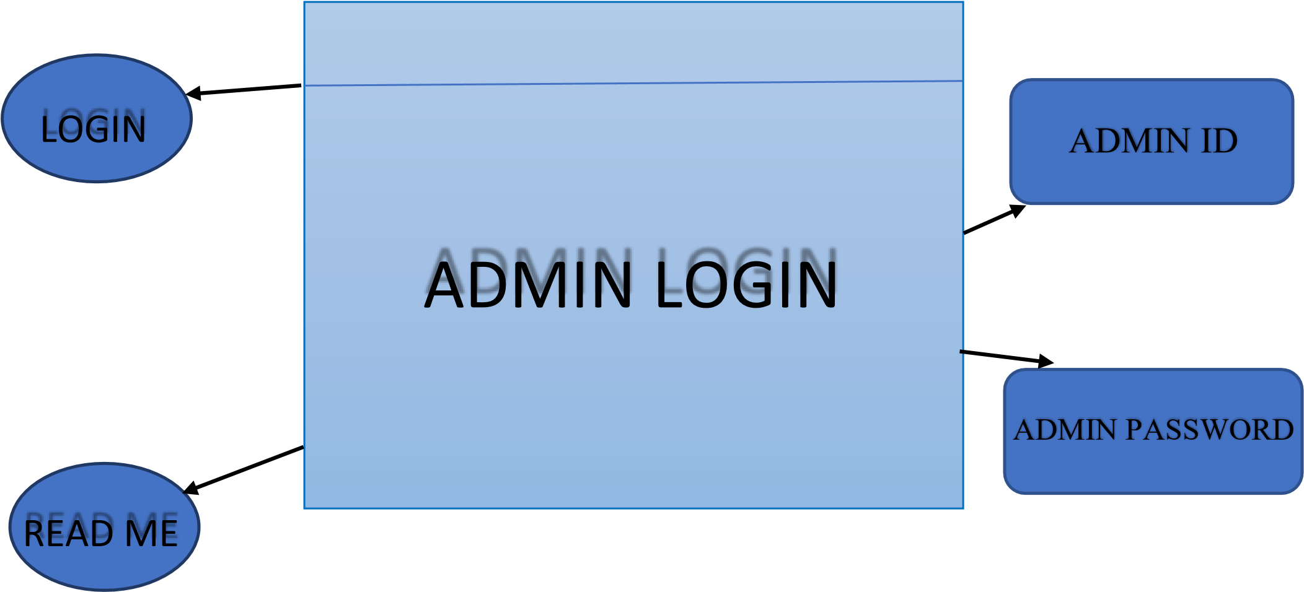
ADMIN SIDE

Slide 7
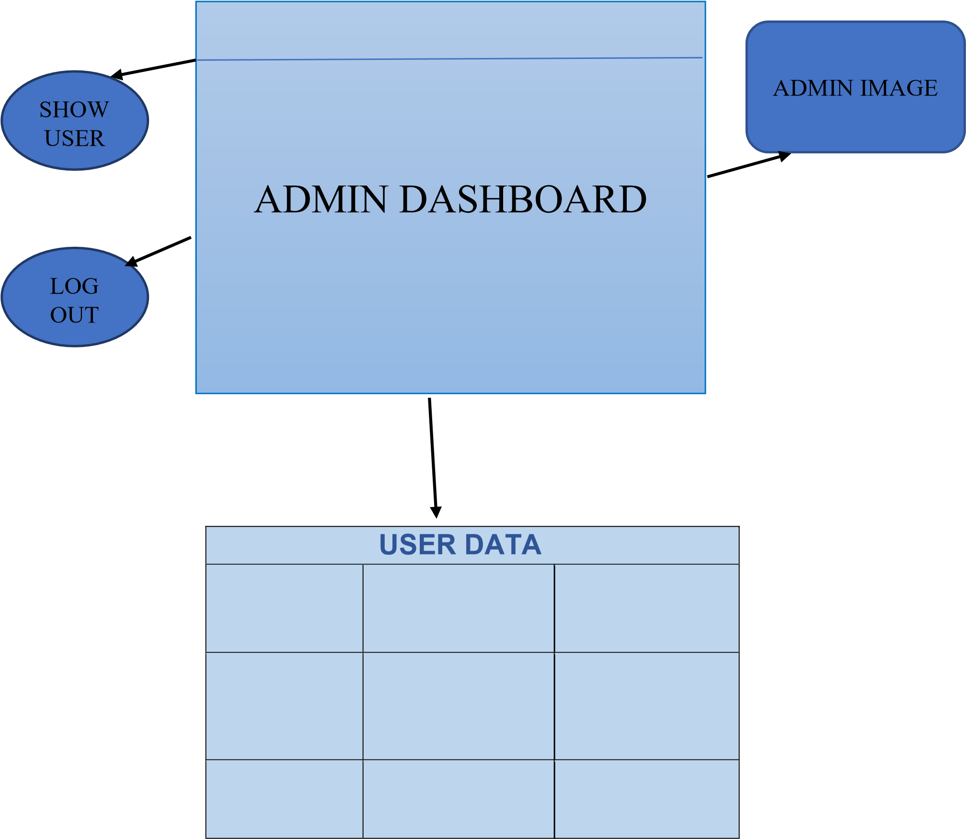
USER DATA

Slide 8
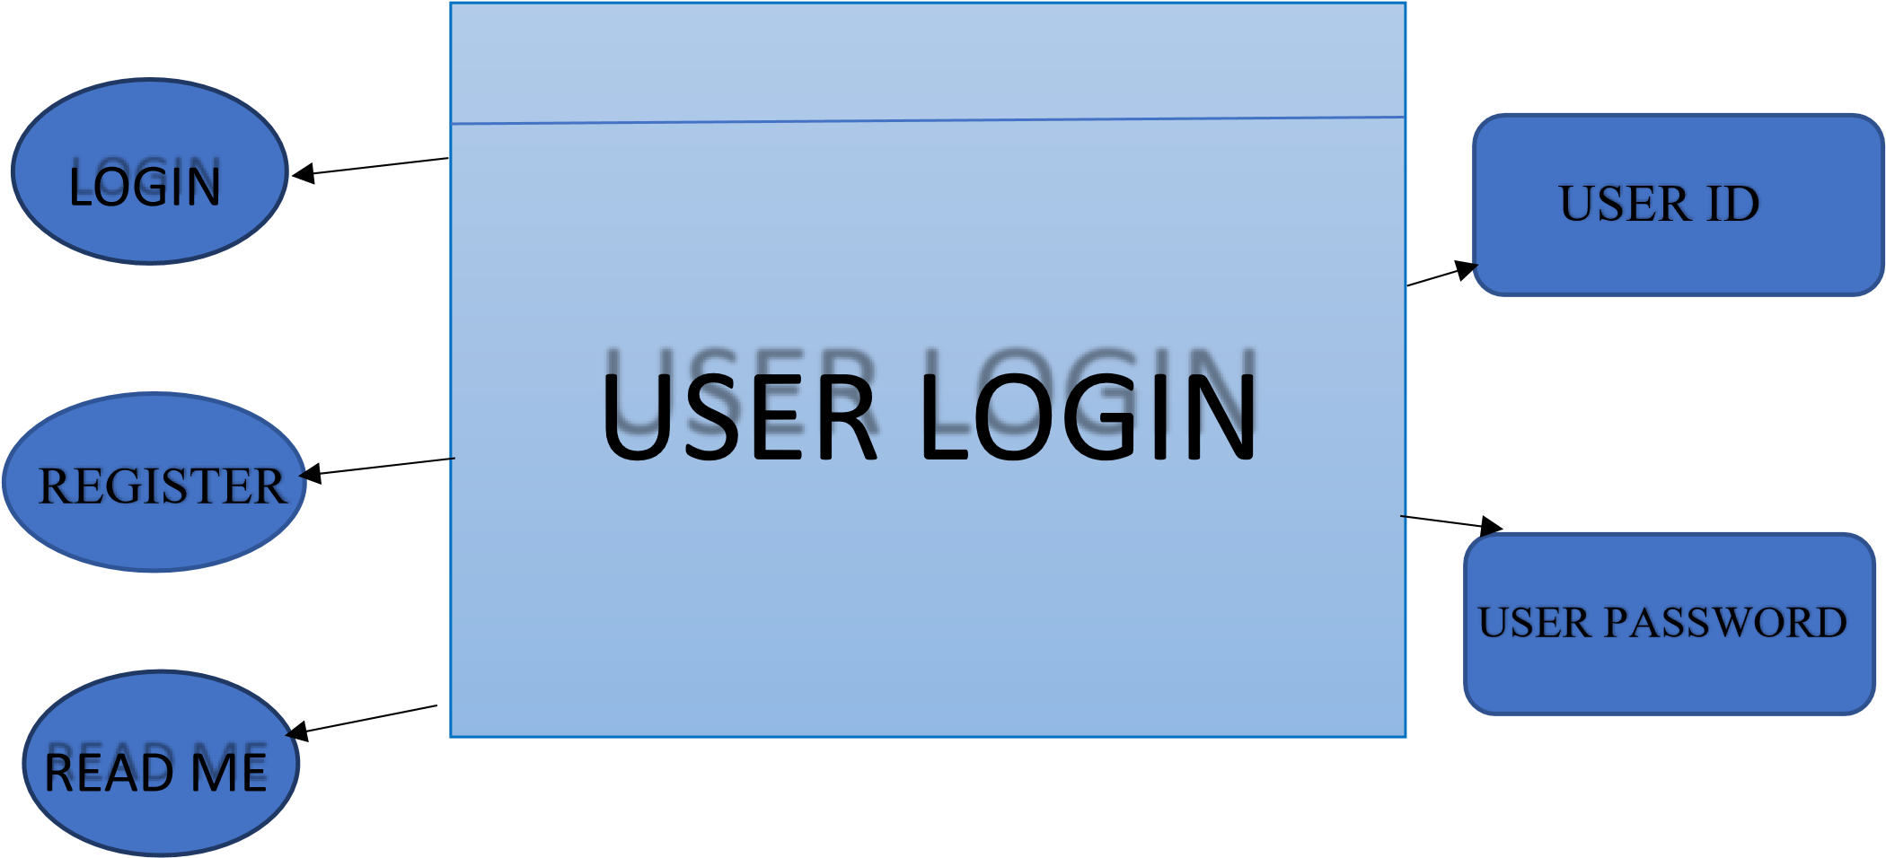
USER SIDE:

Slide 9
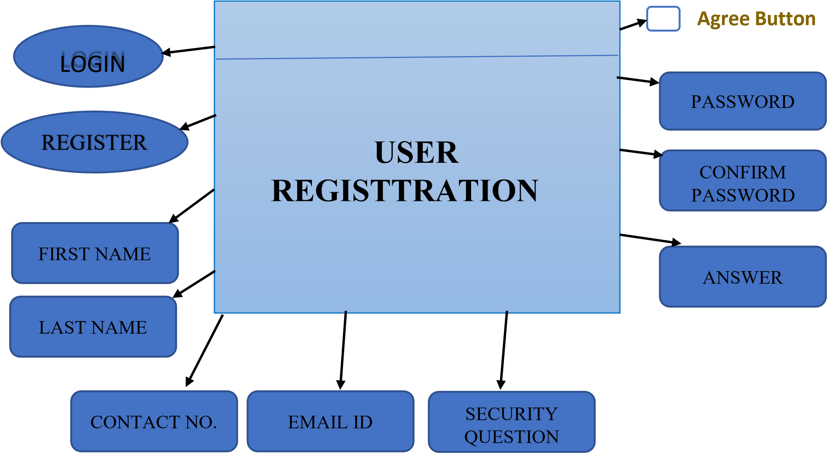

Slide 10
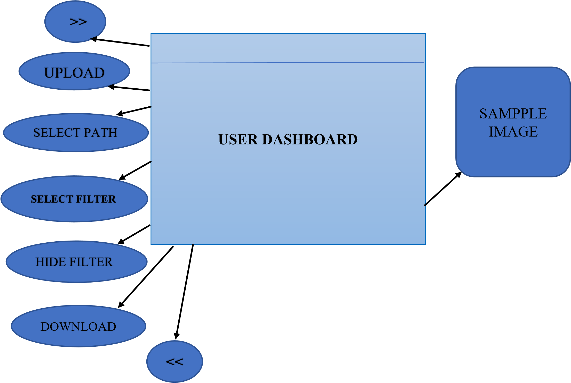

Slide 11








USER
LOG
IN
READ MORE
ADMIN
LOG
IN
D
escription

Slide 12
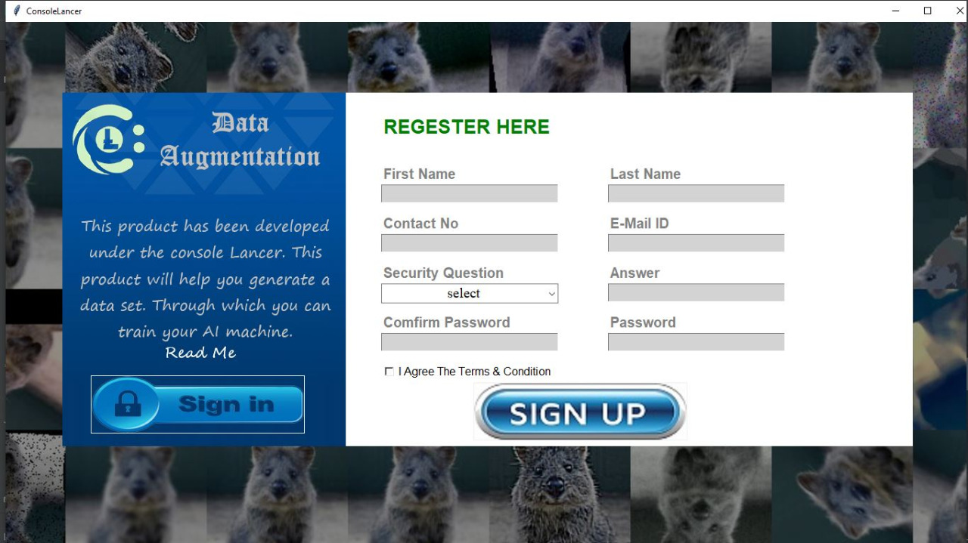
REGISTER HERE

Slide 13
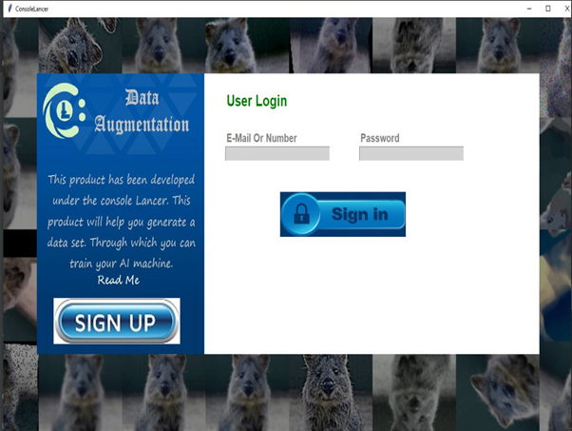

Slide 14
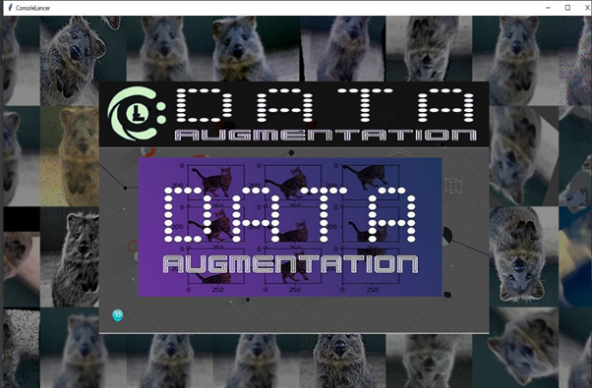

Slide 15
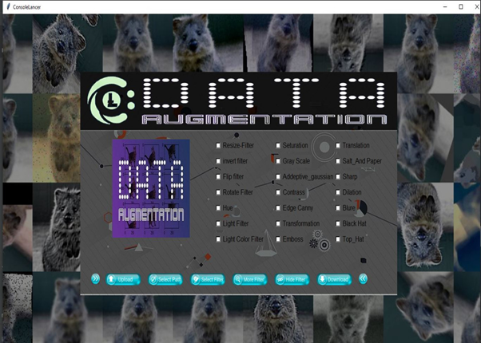

Slide 16
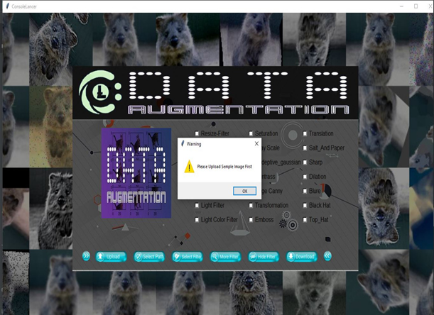

Slide 17
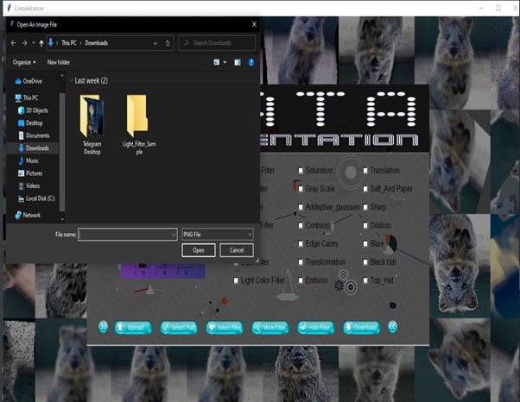

Slide 18
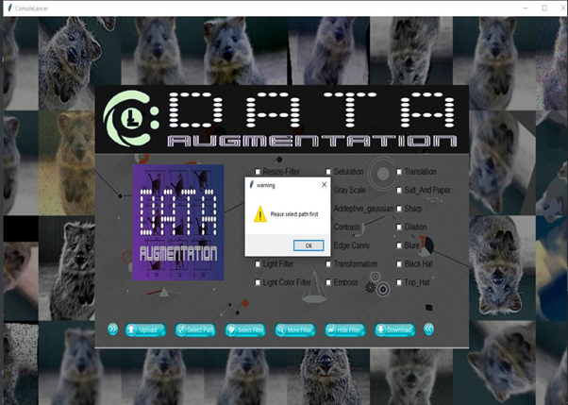

Slide 19
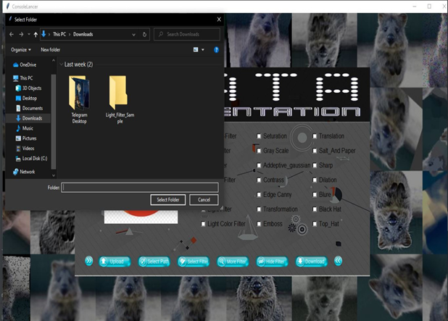

Slide 20
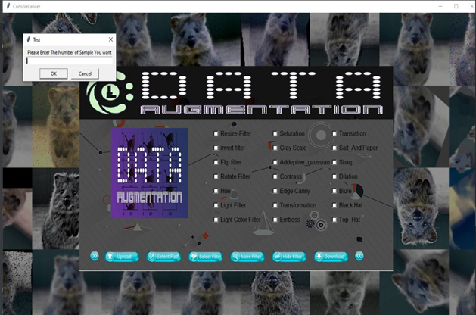

Slide 21


Slide 22
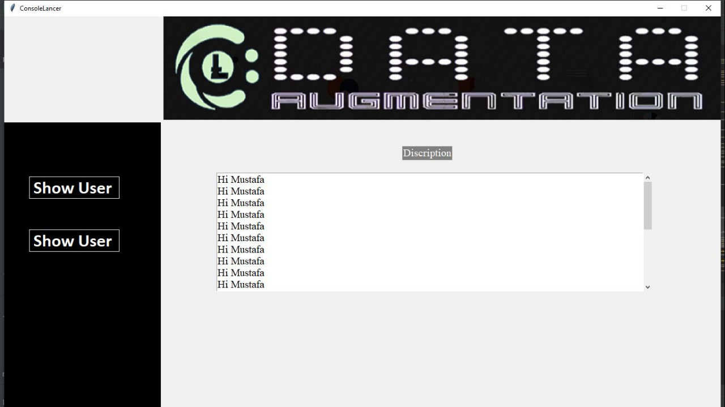

Slide 23
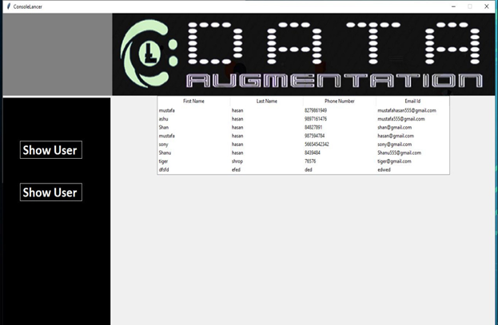

Slide 24



